Slide 1
Lecture 11 Relational Database Design
3rd Normal Form
Good Design
Atomic
Dependencies
BCNF
3rdNF
MVDs
Design Process
United International College

Slide 2
Outline
Good Design
Atomic
Dependencies
BCNF
3rdNF
MVDs
Design Process
Features of Good Relational Design
Atomic Domains and First Normal Form
Functional Dependency Theory
BCNF
3rd Normal Form
Multivalued Dependencies and Decomposition
Database-Design Process

Slide 3
Motivation
Good Design
Atomic
Dependencies
BCNF
3rdNF
MVDs
Design Process
There are some situations that
  BCNF decomposition is not dependency preserving, but
  efficiently checking the dependency violation on updates is important.
Thus, we define a weaker normal form called Third Normal Form (3NF).
  3NF allows some redundancy (with resultant problems; we will see examples later).
  But functional dependencies can be checked on individual relations without computing a join.
  There is always a lossless-join, dependency-preserving decomposition into 3NF.

Slide 4
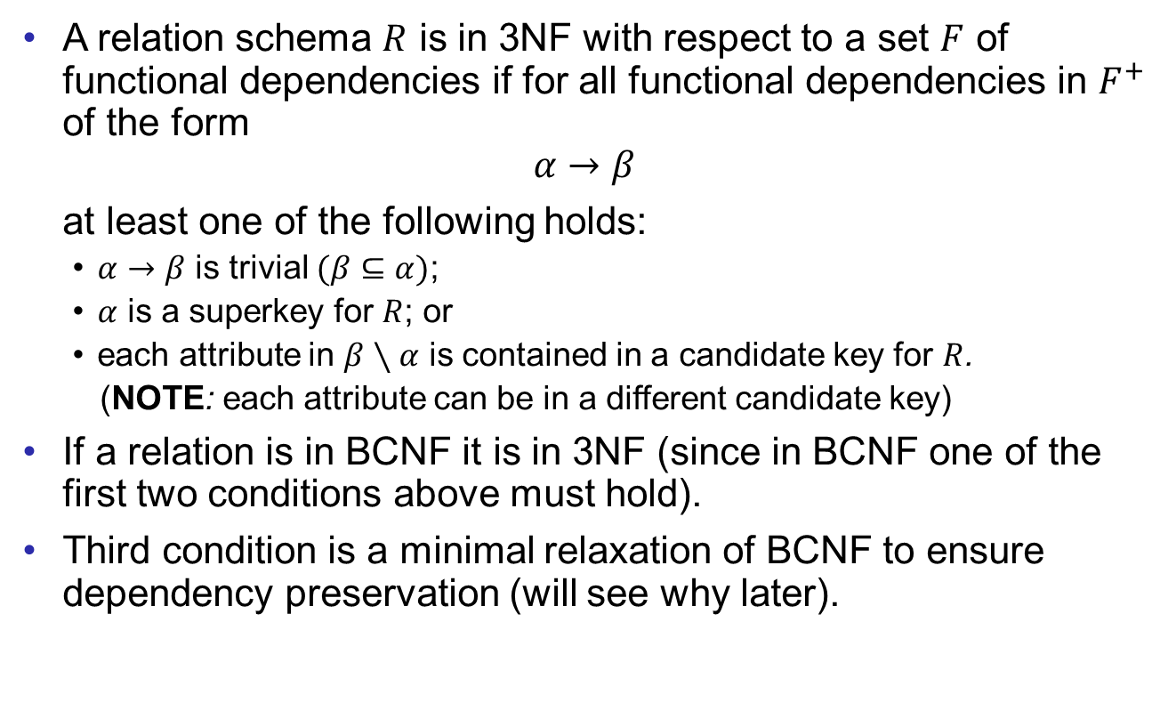
Third Normal Form
Good Design
Atomic
Dependencies
BCNF
3rdNF
MVDs
Design Process
A relation schema $R$ is in 3NF with respect to a set $F$ of
functional dependencies if for all functional dependencies in $F^{+}$
of the form
$$α→β$$
at least one of the following holds:
  $α→β$ is trivial $(β⊆α)$;
  $α$ is a superkey for $R$; or
  each attribute in $β∖α$ is contained in a candidate key for $R$.
  (NOTE: each attribute can be in a different candidate key)
If a relation is in BCNF it is in 3NF (since in BCNF one of the first two conditions above must hold).
Third condition is a minimal relaxation of BCNF to ensure dependency preservation (will see why later).

Slide 5
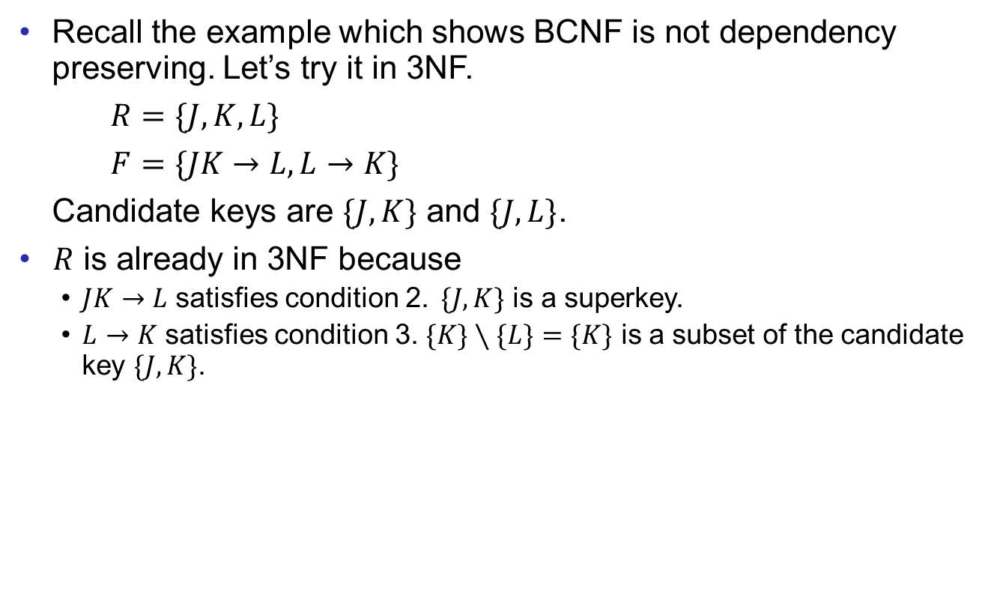
3NF Example
Good Design
Atomic
Dependencies
BCNF
3rdNF
MVDs
Design Process
Recall the example which shows BCNF is not dependency preserving. Let’s try it in 3NF.
$R=\{J, K, L\}$
$F=\{JK→L, L→K\}$
Candidate keys are $\{J,K\}$ and $\{J,L\}$.
$R$ is already in 3NF because
  $JK→L$ satisfies condition 2. $\{J,K\}$ is a superkey.
  $L→K$ satisfies condition 3. $\{K\}∖\{L\}=\{K\}$ is a subset of the candidate key $\{J,K\}$.

Slide 6

Redundancy in 3NF
Good Design
Atomic
Dependencies
BCNF
3rdNF
MVDs
Design Process
We allow redundancies in 3NF.
For example, $R=\{J, K, L\}$, $F=\{JK→L, L→K\}$
J | L | K
j₁ | l₁ | k₁
j₂ | l₁ | k₁
j₃ | l₁ | k₁
_{null} | l₂ | k₂

Slide 7
3NF Decomposition Strategy
Good Design
Atomic
Dependencies
BCNF
3rdNF
MVDs
Design Process
In order to make sure the decomposition is dependency preserving, we decompose the schema by using every functional dependency in an equivalent functional dependency set.
To keep the decomposition simple, we find the “smallest” FD set (canonical cover)
by removing all “useless” (extraneous) attributes from each of the FD.
  We have seen “equivalent” FD set, the closures.
  If two FD sets are equivalent, then one can logically infer the other.
  In other words, the constraints presented by one schema is exactly the same as the other.

Slide 8
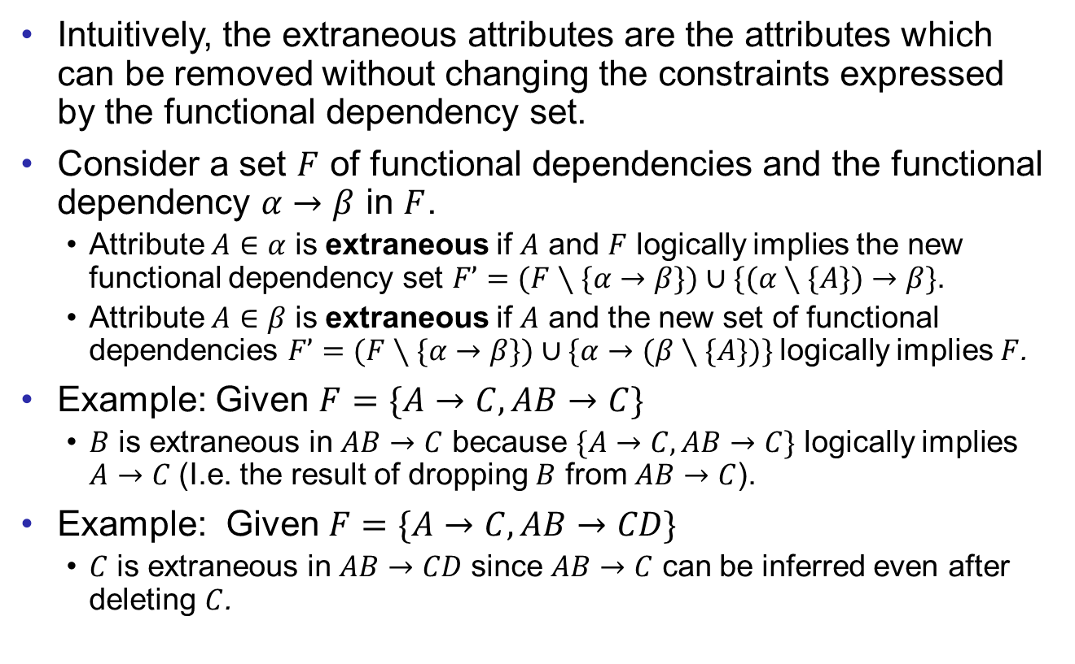
Extraneous Attributes
Good Design
Atomic
Dependencies
BCNF
3rdNF
MVDs
Design Process
Intuitively, the extraneous attributes are the attributes which can be removed without changing the constraints expressed by the functional dependency set.
Consider a set $F$ of functional dependencies and the functional dependency $α→β$ in $F$.
  Attribute $A∈α$ is extraneous if $A$ and $F$ logically implies the new functional dependency set $F’=(F∖\{α→β\})∪\{(α∖\{A\})→β\}$.
  Attribute $A∈β$ is extraneous if $A$ and the new set of functional dependencies $F’=(F∖\{α→β\})∪\{α→(β∖\{A\})\}$logically implies $F$.
Example: Given $F=\{A→C, AB→C\}$
  $B$ is extraneous in $AB→C$ because $\{A→C,AB→C\}$ logically implies $A→C$ (I.e. the result of dropping $B$ from $AB→C$).
Example: Given $F=\{A→C,AB→CD\}$
  $C$ is extraneous in $AB→CD$ since $AB→C$ can be inferred even after deleting $C$.
Notes:
Note: implication in the opposite direction is trivial in each of the cases above, since a “stronger” functional dependency always implies a weaker one.

Slide 9
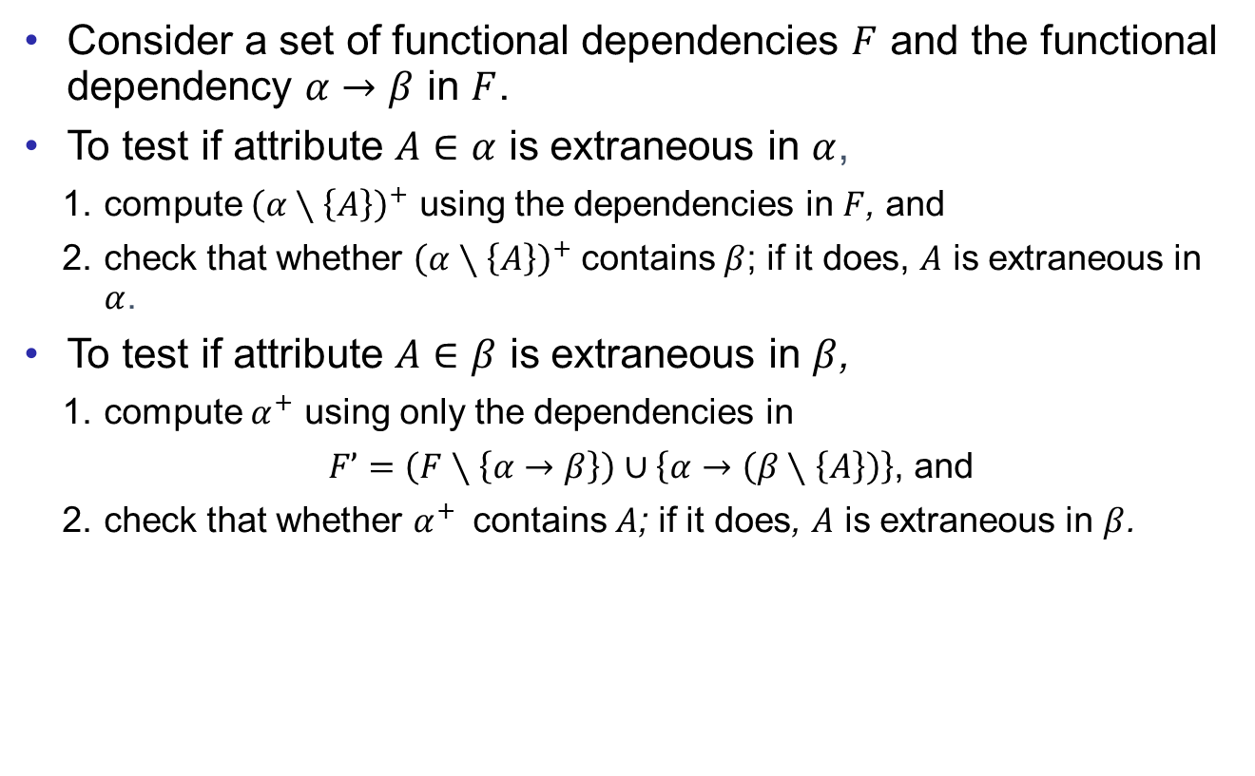
Extraneous Attributes Detection
Good Design
Atomic
Dependencies
BCNF
3rdNF
MVDs
Design Process
Consider a set of functional dependencies $F$ and the functional dependency $α→β$ in $F$.
To test if attribute $A∈α$ is extraneous in $α$,
    compute ${\left(α∖\left\{A\right\}\right)}^{+}$ using the dependencies in $F$, and
    check that whether ${\left(α∖\left\{A\right\}\right)}^{+}$ contains $β$; if it does, $A$ is extraneous in $α$.
To test if attribute $A∈β$ is extraneous in $β$,
    compute $α^{+}$ using only the dependencies in
    $F’=\left(F∖\left\{α→β\right\}\right)∪\left\{α→\left(β∖\left\{A\right\}\right)\right\}$, and
    check that whether $α^{+}$ contains $A$; if it does, $A$ is extraneous in $β$.

Slide 10
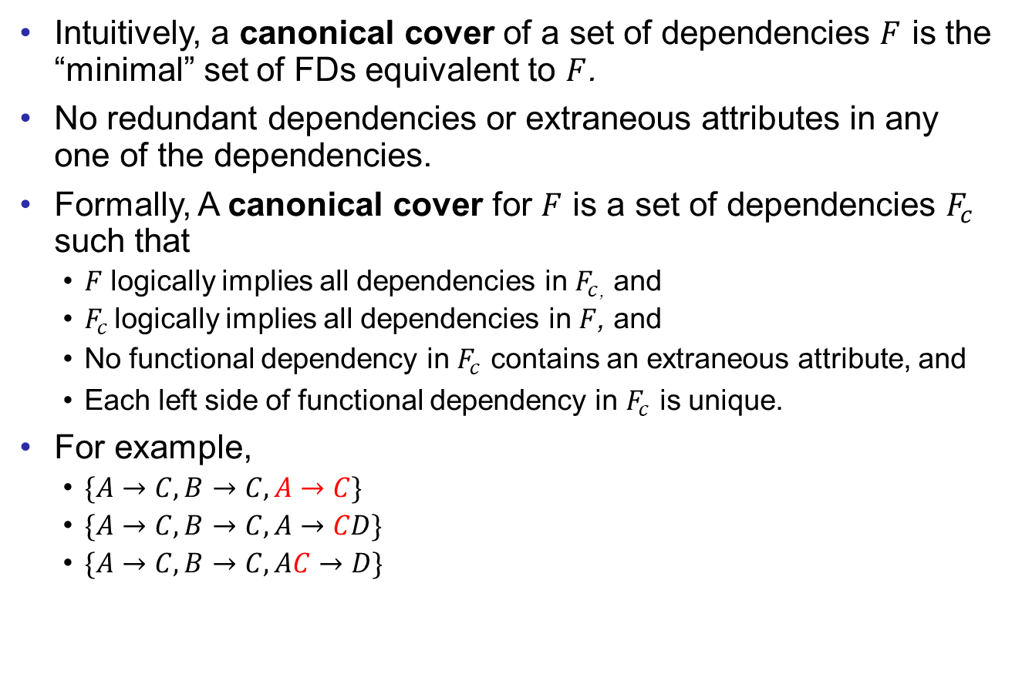
Canonical Cover
Good Design
Atomic
Dependencies
BCNF
3rdNF
MVDs
Design Process
Intuitively, a canonical cover of a set of dependencies $F$ is the “minimal” set of FDs equivalent to $F$.
No redundant dependencies or extraneous attributes in any one of the dependencies.
Formally, A canonical cover for $F$ is a set of dependencies $F_{c}$ such that
  $F$ logically implies all dependencies in $F_{c}$, and
  $F_{c}$ logically implies all dependencies in $F$, and
  No functional dependency in $F_{c}$ contains an extraneous attribute, and
  Each left side of functional dependency in $F_{c}$ is unique.
For example,
  $\{A→C,B→C,A→C\}$
  $\{A→C,B→C,A→CD\}$
  $\{A→C,B→C,AC→D\}$

Slide 11
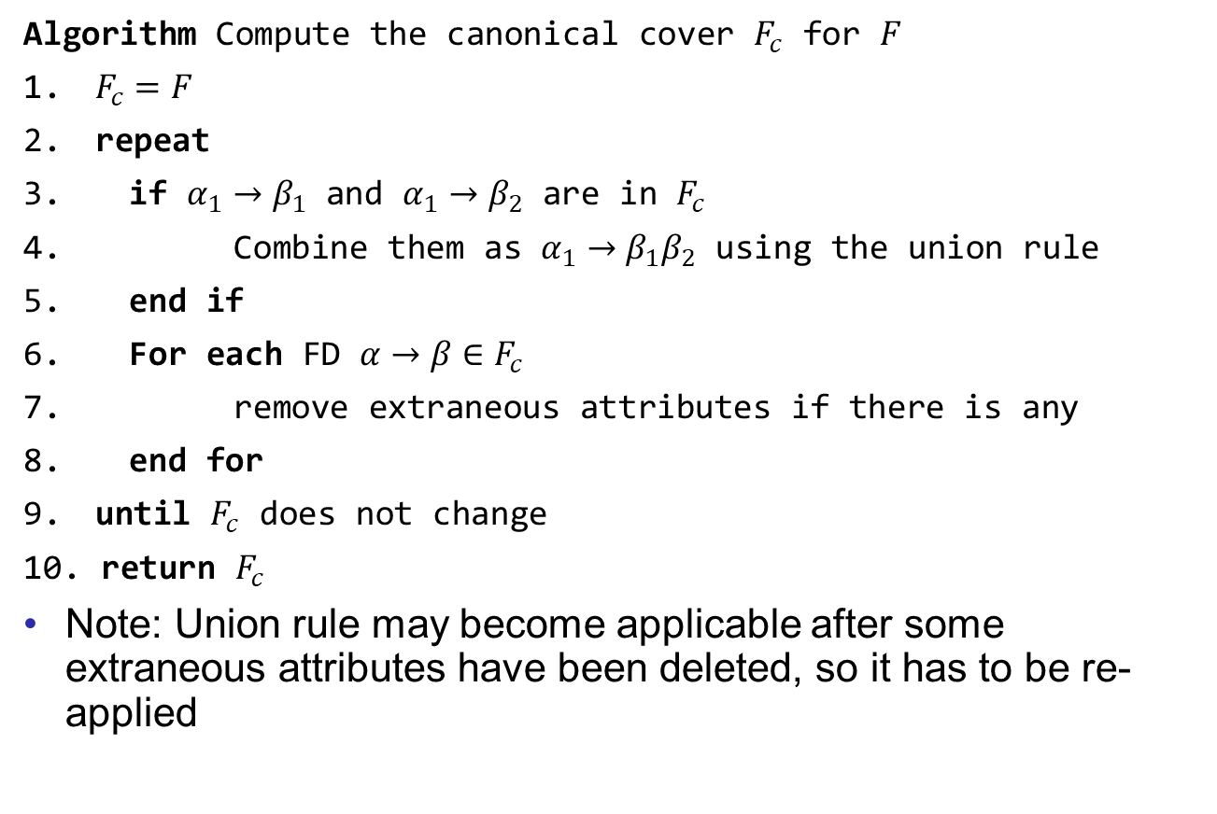
Find Canonical Cover
Good Design
Atomic
Dependencies
BCNF
3rdNF
MVDs
Design Process
Algorithm Compute the canonical cover $F_{c}$ for $F$
$F_{c}=F$
repeat
if $α_{1}→β_{1}$ and $α_{1}→β_{2}$ are in $F_{c}$
Combine them as $α_{1}→β_{1}β_{2}$ using the union rule
end if
For each FD $α→β∈F_{c}$
remove extraneous attributes if there is any
end for
until $F_{c}$ does not change
return $F_{c}$
Note: Union rule may become applicable after some extraneous attributes have been deleted, so it has to be re-applied

Slide 12
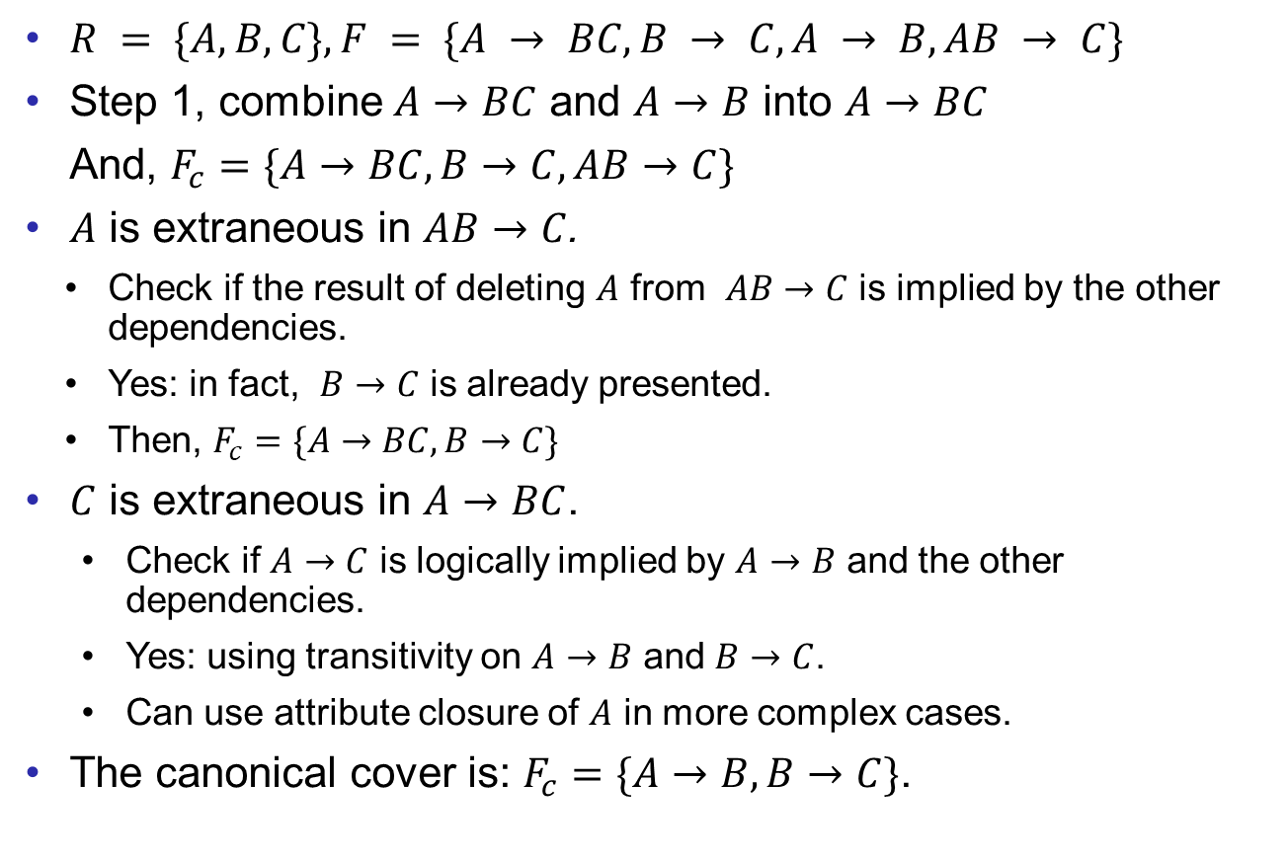
Example
Good Design
Atomic
Dependencies
BCNF
3rdNF
MVDs
Design Process
$R = \{A, B, C\}, F = \{A → BC, B → C, A → B, AB → C\}$
Step 1, combine $A→BC$ and $A→B$ into $A→BC$
  And, $F_{c}=\{A→BC,B→C,AB→C\}$
$A$ is extraneous in $AB→C$.
  Check if the result of deleting $A$ from $AB→C$ is implied by the other dependencies.
  Yes: in fact, $B→C$ is already presented.
  Then, $F_{c}=\{A→BC,B→C\}$
$C$ is extraneous in $A→BC$.
  Check if $A→C$ is logically implied by $A→B$ and the other dependencies.
  Yes: using transitivity on $A→B$ and $B→C$.
  Can use attribute closure of $A$ in more complex cases.
The canonical cover is: $F_{c}=\{A→B,B→C\}$.

Slide 13
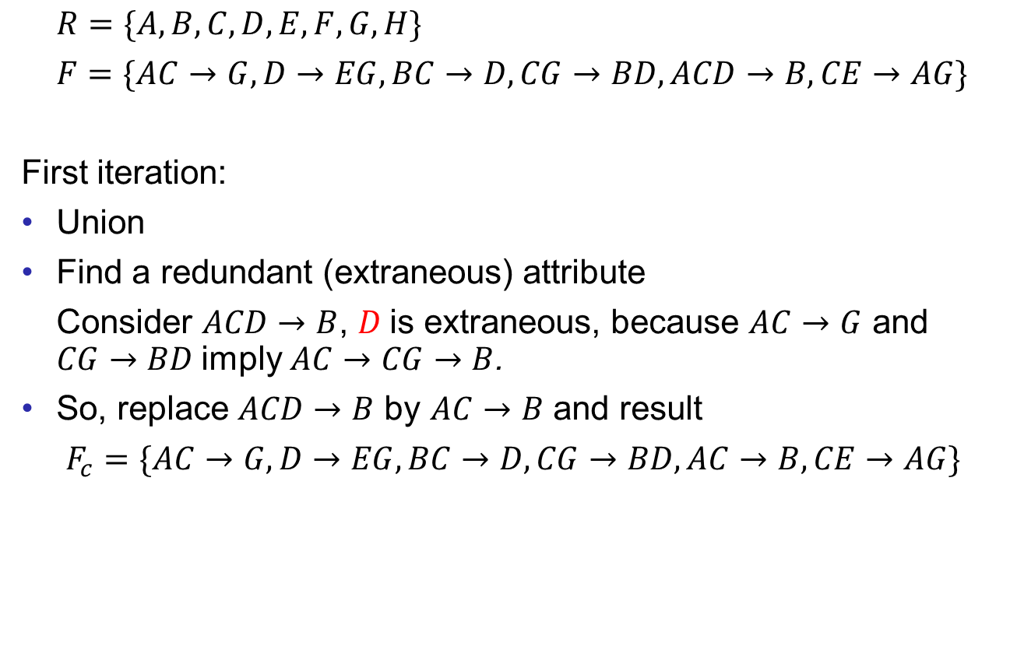
More Examples
Good Design
Atomic
Dependencies
BCNF
3rdNF
MVDs
Design Process
$R=\{A,B,C,D,E,F,G,H\}$
$F=\{AC→G, D→EG, BC→D, CG→BD, ACD→B, CE→AG\}$
First iteration:
Union
Find a redundant (extraneous) attribute
Consider $ACD→B$, $D$is extraneous, because $AC→G$ and $CG→BD$imply $AC→CG→B$.
So, replace $ACD→B$ by $AC→B$ and result
$F_{c}=\{AC→G,D→EG,BC→D,CG→BD,AC→B,CE→AG\}$

Slide 14
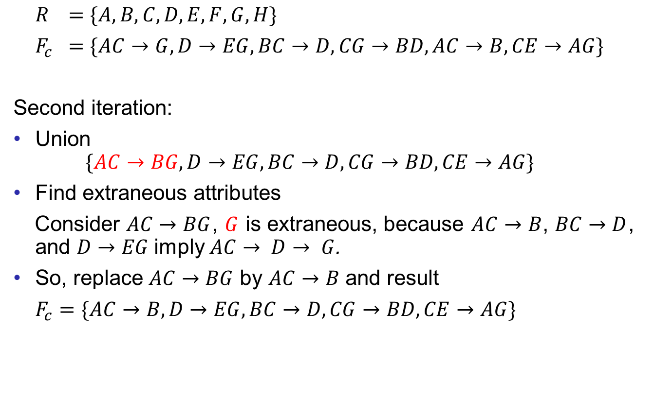
More Examples
Good Design
Atomic
Dependencies
BCNF
3rdNF
MVDs
Design Process
$R$ $=\{A,B,C,D,E,F,G,H\}$
$F_{c}$ $=\{AC→G, D→EG, BC→D, CG→BD, AC→B, CE→AG\}$
Second iteration:
Union
$$\{AC→BG, D→EG, BC→D, CG→BD, CE→AG\}$$
Find extraneous attributes
Consider $AC→BG$, $G$ is extraneous, because $AC→B$, $BC→D$, and $D→EG$imply $AC→ D→ G$.
So, replace $AC→BG$ by $AC→B$ and result
$F_{c}=\{AC→B, D→EG, BC→D, CG→BD, CE→AG\}$

Slide 15
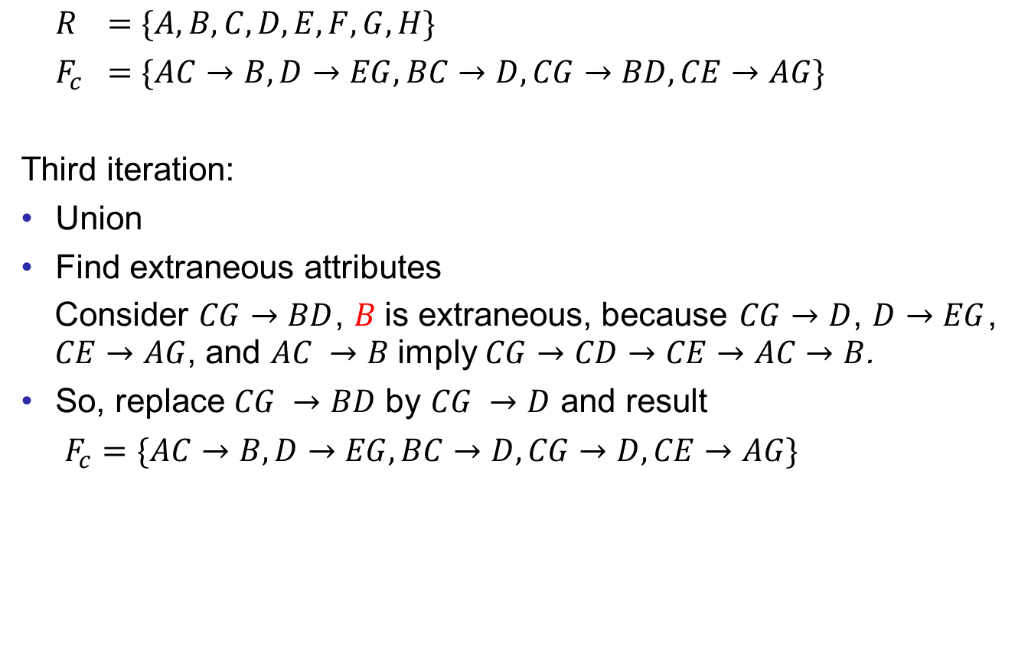
More Examples
Good Design
Atomic
Dependencies
BCNF
3rdNF
MVDs
Design Process
$R$ $=\{A,B,C,D,E,F,G,H\}$
$F_{c}$ $=\{AC→B, D→EG, BC→D, CG→BD, CE→AG\}$
Third iteration:
Union
Find extraneous attributes
Consider $CG→BD$, $B$is extraneous, because $CG→D$, $D→EG$, $CE→AG$, and $AC →B$imply $CG→CD→CE→AC→B$.
So, replace $CG →BD$ by $CG →D$ and result
$F_{c}=\{AC→B, D→EG, BC→D, CG→D, CE→AG\}$

Slide 16
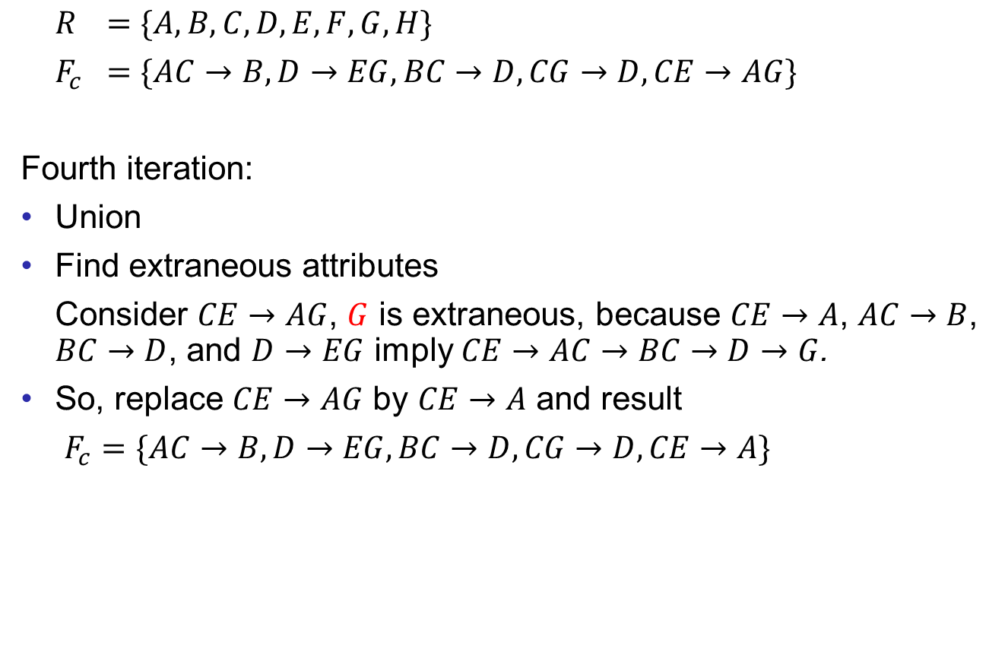
More Examples
Good Design
Atomic
Dependencies
BCNF
3rdNF
MVDs
Design Process
$R$ $=\{A,B,C,D,E,F,G,H\}$
$F_{c}$ $=\{AC→B, D→EG, BC→D, CG→D, CE→AG\}$
Fourth iteration:
Union
Find extraneous attributes
Consider $CE→AG$, $G$ is extraneous, because $CE→A$, $AC→B$, $BC→D$, and $D→EG$ imply $CE→AC→BC→D→G$.
So, replace $CE→AG$ by $CE→A$ and result
$F_{c}=\{AC→B, D→EG, BC→D, CG→D, CE→A\}$

Slide 17

More Examples
Good Design
Atomic
Dependencies
BCNF
3rdNF
MVDs
Design Process
$R$ $=\{A,B,C,D,E,F,G,H\}$
$F_{c}$ $=\{AC→B, D→EG, BC→D, CG→D, CE→A\}$
No more extraneous attributes. $F_{c}$ is the canonical cover.

Slide 18
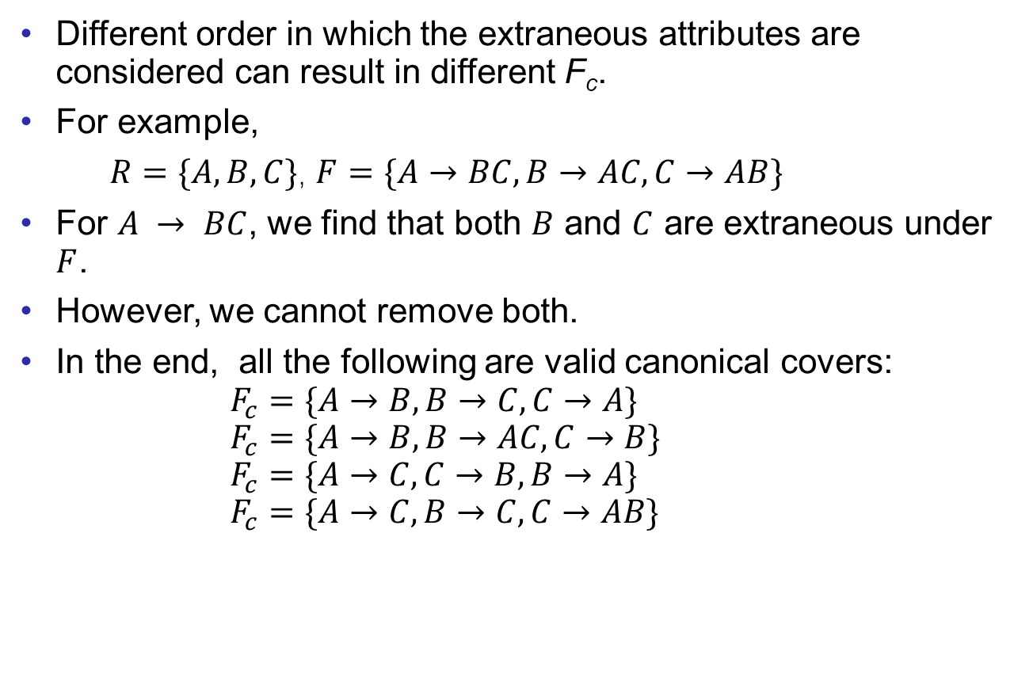
Ununiqueness of the Canonical Cover
Good Design
Atomic
Dependencies
BCNF
3rdNF
MVDs
Design Process
Different order in which the extraneous attributes are considered can result in different F_{c}.
For example,
$R=\{A, B, C\}$, $F=\{A→BC, B→AC, C→AB\}$
For $A → BC$, we find that both $B$ and $C$ are extraneous under $F$.
However, we cannot remove both.
In the end, all the following are valid canonical covers:
          $$F_{c}=\{A→B, B→C, C→A\}$$
          $$F_{c}=\{A→B, B→AC, C→B\}$$
          $$F_{c}=\{A→C, C→B, B→A\}$$
          $$F_{c}=\{A→C, B→C, C→AB\}$$

Slide 19
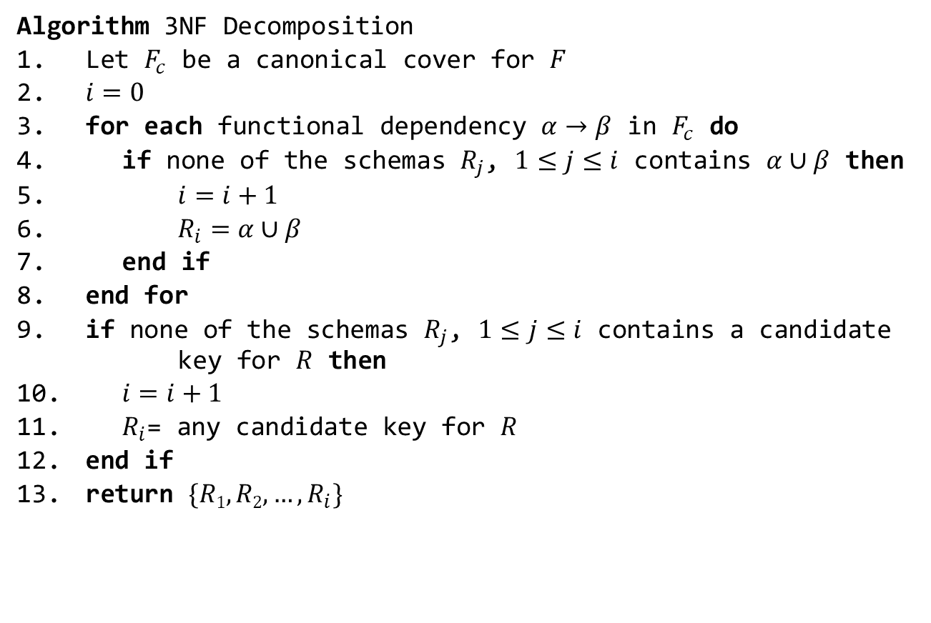
3NF Decomposition
Good Design
Atomic
Dependencies
BCNF
3rdNF
MVDs
Design Process
Algorithm 3NF Decomposition
Let $F_{c}$ be a canonical cover for $F$
$i=0$
for each functional dependency $α→β$ in $F_{c}$ do
if none of the schemas $R_{j}$, $1≤j≤i$ contains $α∪β$ then
$i=i+1$
$R_{i}=α∪β$
end if
end for
if none of the schemas $R_{j}$, $1≤j≤i$ contains a candidate key for $R$ then
$i=i+1$
$R_{i}$= any candidate key for $R$
end if
return $\{R1, R2, …, R_{i}\}$

Slide 20
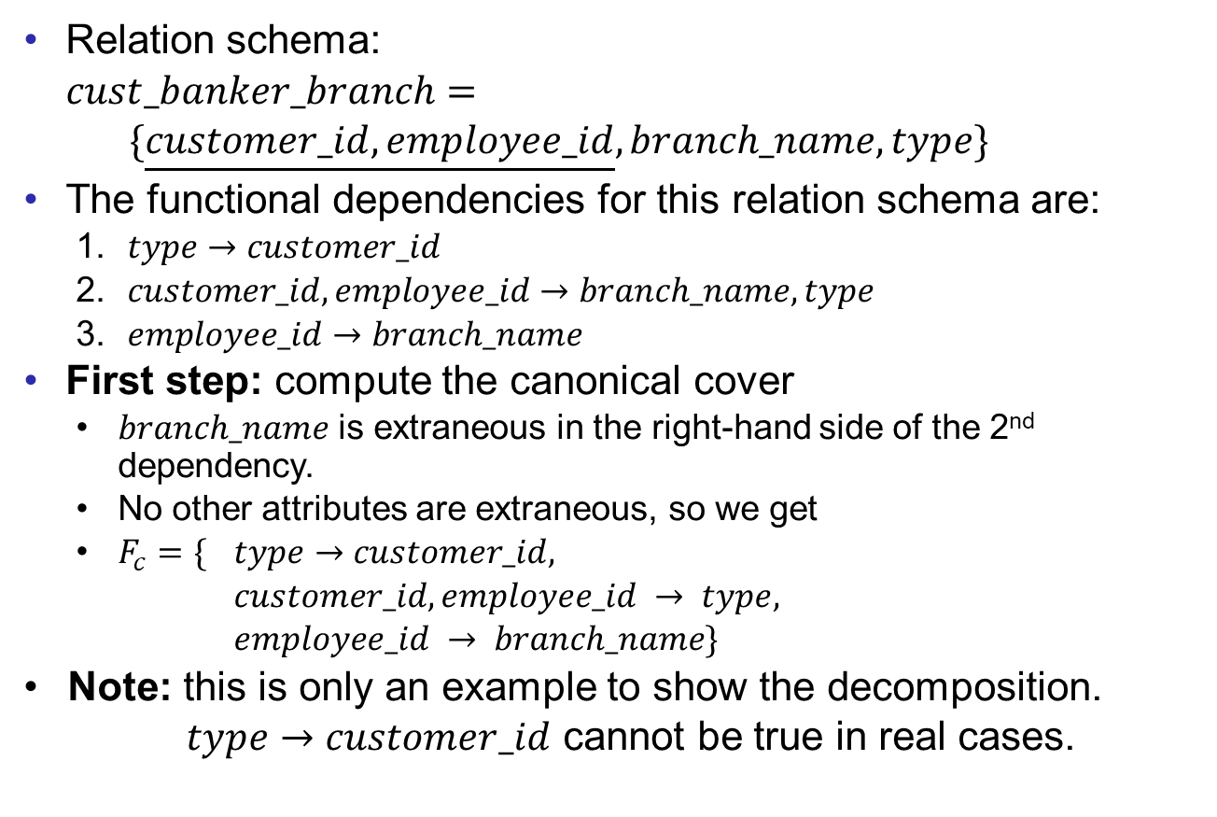
3NF Decomposition Example
Good Design
Atomic
Dependencies
BCNF
3rdNF
MVDs
Design Process
Relation schema:
$cust_banker_branch=$
$\{\underline{customer_id, employee_id}, branch_name, type\}$
The functional dependencies for this relation schema are:
    $type→customer_id$
    $customer_id, employee_id→branch_name, type$
    $employee_id→branch_name$
First step: compute the canonical cover
    $branch_name$ is extraneous in the right-hand side of the 2nd dependency.
    No other attributes are extraneous, so we get
    $F_{c}=\{$ $type→customer_id,$
    $customer_id, employee_id → type,$
    $employee_id → branch_name\}$
  Note: this is only an example to show the decomposition.
  $type→customer_id$ cannot be true in real cases.

Slide 21

3NF Decomposition Example
Good Design
Atomic
Dependencies
BCNF
3rdNF
MVDs
Design Process
Relation schema:
$cust_banker_branch=$
$$\{\underline{customer_id, employee_id}, branch_name, type\}$$
The canonical cover $F_{c}=$
    $type → customer_id$
    $customer_id, employee_id→type$
    $employee_id→branch_name$
Second step: decompose the schema using every FD in $F_{c}$
    $R_{1}=\{\underline{type}, customer_id\}$
    $R_{2}=\{\underline{customer_id, employee_id}, type\}$
    $R_{3}=\{\underline{employee_id}, branch_name\}$
  $R_{2}$ contains a candidate key of the original schema, so no further relation schema is required.

Slide 22
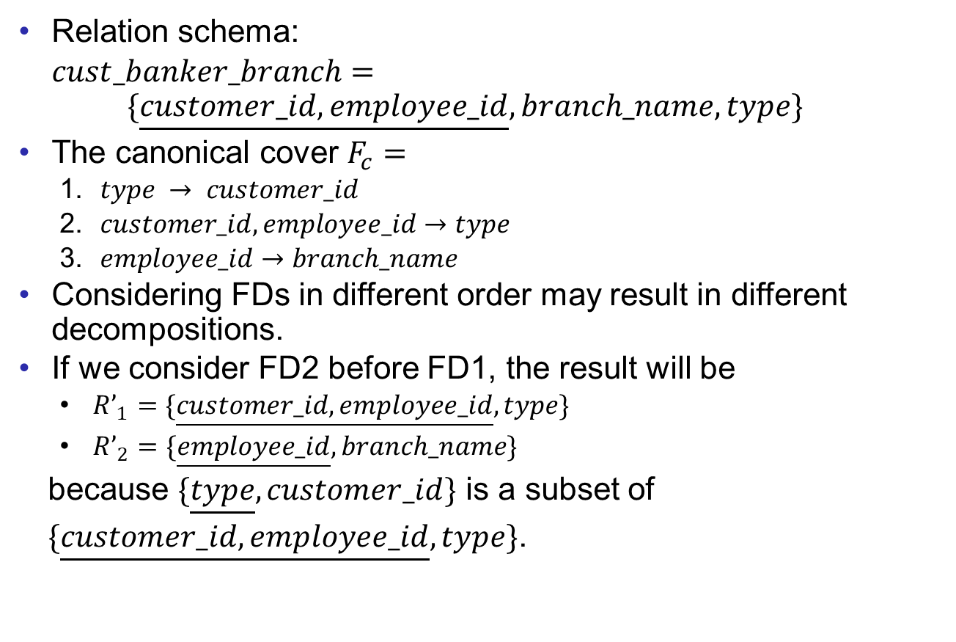
3NF Decomposition Example
Good Design
Atomic
Dependencies
BCNF
3rdNF
MVDs
Design Process
Relation schema:
$cust_banker_branch=$
$$\{\underline{customer_id, employee_id}, branch_name, type\}$$
The canonical cover $F_{c}=$
    $type → customer_id$
    $customer_id, employee_id→type$
    $employee_id→branch_name$
Considering FDs in different order may result in different decompositions.
If we consider FD2 before FD1, the result will be
    $R’_{1}=\{\underline{customer_id, employee_id}, type\}$
    $R’_{2}=\{\underline{employee_id}, branch_name\}$
  because $\{\underline{type}, customer_id\}$ is a subset of
  $\{\underline{customer_id, employee_id}, type\}$.

Slide 23
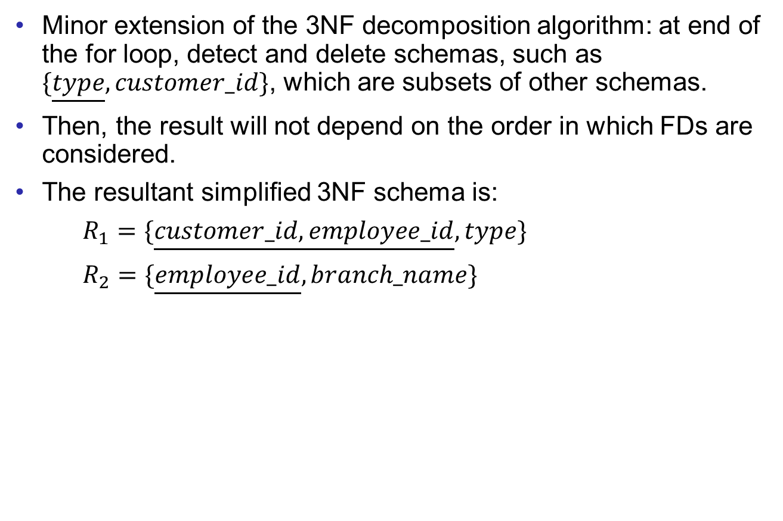
3NF Decomposition Example
Good Design
Atomic
Dependencies
BCNF
3rdNF
MVDs
Design Process
Minor extension of the 3NF decomposition algorithm: at end of the for loop, detect and delete schemas, such as $\{\underline{type}, customer_id\}$, which are subsets of other schemas.
Then, the result will not depend on the order in which FDs are considered.
The resultant simplified 3NF schema is:
$R_{1}=\{\underline{customer_id, employee_id}, type\}$
$R_{2}=\{\underline{employee_id}, branch_name\}$

Slide 24
Comparison of BCNF and 3NF
Good Design
Atomic
Dependencies
BCNF
3rdNF
MVDs
Design Process
It is always possible to decompose a relation into a set of relations that are in 3NF such that:
  the decomposition is lossless.
  the dependencies are preserved.
It is always possible to decompose a relation into a set of relations that are in BCNF such that:
  the decomposition is lossless.
  it may not be possible to preserve dependencies.

Slide 25
End of Lecture 11
Good Design
Atomic
Dependencies
BCNF
3rdNF
MVDs
Design Process

